Slide 1

Group Project
Fraudulent Claim Detection
21 April 2025

Slide 2
Team Members
Niranjan Singh
Nitish Narayanan
Member
Member

Slide 3
Introduction
Our project aims to build a model to classify insurance claims as either fraudulent or legitimate based on historical claim details and customer profiles. By using features such as claim amounts, customer profiles, claim types and approval times, the company aims to predict the claims that are likely to be fraudulent before they are approved.

Slide 4

Background Project
Case Study:
Global Insure, an insurance company, is facing significant financial losses due to fraudulent claims. The current manual inspection process for identifying fraudulent claims is inefficient and time-consuming. The goal is to use a data-driven approach to classify claims as either fraudulent or legitimate early in the approval process. This will help minimize financial losses and improve the efficiency of the claims handling process.

Slide 5

Project Analysis
Detect Patterns
Predict a fraud !
analyse historical claim data to detect patterns that indicate fraudulent claims
Based on past data, can we predict the likelihood of fraud for an incoming claim?
Features Predicting Patterns
How to Improve Fraud detection?
Which features can help us detect the patterns of fraud?
What insights can be drawn from the model that can help in improving the fraud detection process?

Slide 6



Project Objectives
Predicting Fraudulent Claims
Leveraging Key Features
Optimizing Claim Approval
Build a machine learning model to classify insurance claims as fraudulent or legitimate, improving early detection and reducing financial losses.
Use historical claim data, customer profiles, and claim types as features to train the model, enhancing its ability to recognize patterns indicative of fraud.
Enable proactive fraud detection before claims are approved, streamlining the process and minimizing manual inspections

Slide 7

Methodology
Data Preparation:
Preprocessing the data to get it ready for analysis
Data Cleaning:
Handling missing values, outliers, and any inconsistencies in the data
Train-Validation Split:
Dividing the data into training (70%) and validation (30%) datasets
Exploratory Data Analysis (EDA) :
Performing an EDA on the training data to understand patterns and relationships between features and fraud

Slide 8
Methodology
Feature Engineering :
Creating new features and transforming existing ones to improve model performance.
Model Building :
Using machine learning algorithms to build a predictive model
Prediction and Evaluation :
Evaluating the model's performance using appropriate metrics like accuracy, precision, recall, F1-score, and confusion matrix

Slide 9
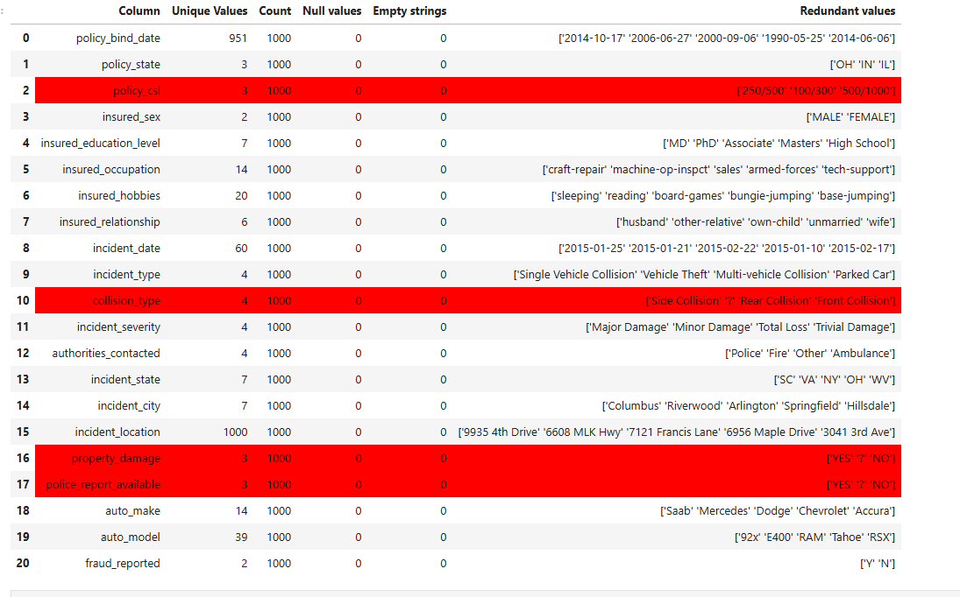
Data Preparation and Cleaning
Initial Steps which were followed were:
Handling null values and removing it as well as handling redundant values
Removing null value columns and also removing ‘?’
Identifying Negative values
Identifying and removing near unique values with a threshold value of 0.75
Lastly, fixing the data

Slide 10
Train-Test Split
Train & Test Split is done in order to create Training data on which the model will be run and then running the same model on Test data as well.
The Train- Test Split which was done was 70/30. i.e., 70% of data was taken for training the model and then 30% of data was taken to test the model.

Slide 11
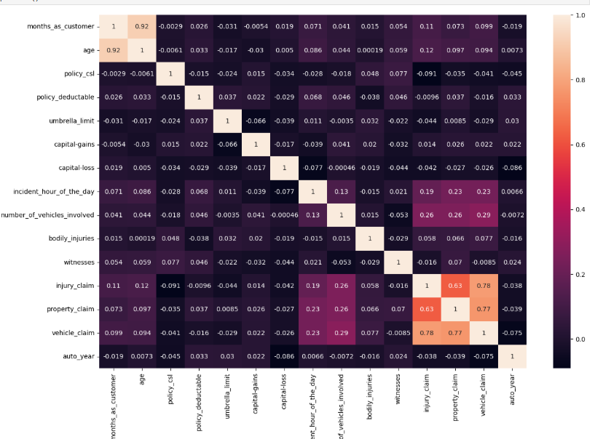
Exploratory Data Analysis
EDA was done on the Training data and overall insights which we saw was:
High-Value Claims:
Both the EDA and correlation analysis reveal that high-value claims (e.g., property and vehicle claims) are right-skewed and often correlate strongly with fraud-related features. These claims should be flagged for closer inspection in fraud detection models.
Claims Interrelationships:
The strong correlations between injury_claim, property_claim, and vehicle_claim suggest that these claims often occur together. Fraudulent claims are more likely to involve multiple types of damages, warranting further investigation when these features appear together.

Slide 12
Exploratory Data Analysis
Bodily Injuries:
Bodily injuries show a significant correlation with both injury_claim and vehicle_claim, indicating that these types of claims are often linked. Claims with higher bodily injuries are more likely to be fraudulent, particularly when multiple claim types are involved.
Customer Age and Tenure:
The strong positive correlation between age and months_as_customer suggests that older customers tend to have longer relationships with the insurance company. Older customers with higher-value claims should be monitored closely for potential fraud.
Witnesses and Claims:
The negative correlation between bodily_injuries and witnesses suggests that severe injury claims might often lack witnesses, making them a potential indicator of fraud.
Umbrella Limit and Claims:
There is a slight negative correlation between umbrella_limit and the various types of claims, suggesting that higher umbrella limits are not strongly linked to larger claims, but they might be associated with higher-risk policies.

Slide 13
Feature Engineering
Post EDA - also doing univariate and bi-variate analysis, our next step was to do Feature engineering. Feature engineering is done to transform raw data into meaningful features that improve the performance of machine learning models.
Under Feature Engineering Process, we carried out following feature creation:
Policy CSL Levels Segmentation:
The policy_csl feature was segmented into three levels: Low, Medium, and High based on predefined bins.
Customer Tenure Level:
months_as_customer was binned into categories such as New, 1-3yrs, 3-5yrs, and Long-term, representing customer tenure.
Date-based Features:
The incident_date and incident_datetime features were used to extract new features like incident year, incident month, incident day of the week, and incident hour. A weekday flag was also created.

Slide 14
Feature Engineering
Total Claim Ratio:
A new feature, total_claim_ratio, was created by dividing the total claim amount by the sum of individual claims (injury_claim, property_claim, vehicle_claim), helping to assess the proportion of the total claim.
Umbrella Limit Flag:
The umbrella_limit_flag was created to indicate if the umbrella limit is greater than 0, helping to distinguish between policies with and without umbrella coverage.
Age and Deductible Interaction:
The interaction between age and policy_deductable was calculated, which may reveal if higher deductibles impact older customers.
Claim per Month:
A feature, claim_per_month, was derived by dividing the total claim amount by the months as customer, indicating the claim rate per customer.
Risky Occupation Flag:
Risky occupations like student, unemployed, and self-employed were flagged based on the insured_occupation feature, assuming these occupations could be more prone to fraud.
After this we dropped redundant data and combined values in categorical columns, created dummy variables and did scaling of values

Slide 15
Model Building
We did model building with two machine learning models: Logistic Regression and Random Forest
Logistic Regression Analysis:
R-squared:
0.522 – This indicates that approximately 52.2% of the variance in the target variable (Y) is explained by the model. While not exceptionally high, it suggests that the model captures a moderate amount of the variation in the data.
Coefficients:
insuranced_hobbies_chess (0.6865): This feature has a positive effect on the target variable. For every unit increase in insuranced_hobbies_chess, the target variable (Y) is expected to increase by 0.6865, assuming other variables remain constant.
insuranced_hobbies_cross-fit (0.6865): Similar to hobbies_chess, this feature also has a positive effect on the target variable.
incident_severity_Minor Damage (-0.6785): The negative coefficient suggests that as the severity of damage increases from Minor Damage to higher severities, the target variable (Y) decreases. Specifically, 1 unit increase in Minor Damage is associated with a 0.6785 decrease in Y.
incident_severity_Total Loss (-0.5928): This feature also negatively impacts the target variable, indicating that higher severity (Total Loss) claims are associated with a decrease in the target variable.
incident_severity_Trivial Damage (-0.6640): Like the others, higher trivial damage severity is associated with a decrease in the target variable.
P-values:
All the P-values are < 0.05, indicating that the coefficients for each feature are statistically significant and provide meaningful contributions to the model.

Slide 16
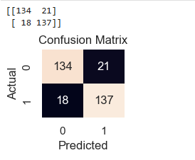
Model Building
Logistic Regression Analysis:
T-Statistics:
t-statistics are used to assess the significance of each coefficient. Values that are larger than 2 (in absolute value) generally indicate that the feature has a significant impact on the dependent variable. In this case, the features have high t-statistics, suggesting significant relationships.
Other Metrics:
Omnibus Test: Suggests that the residuals are approximately normally distributed.
Durbin-Watson: A value of 0.989 indicates some positive autocorrelation in the residuals, suggesting that the model may need further refinement for time-series data.
Skew: A negative skew of -0.237 suggests a slight left skew in the data.
Kurtosis: The kurtosis value of 5.161 indicates that the data has heavier tails than a normal distribution.
Model Performance Metrics:
Sensitivity (Recall): 88.39%
Specificity: 86.45%
Precision: 86.71%
F1-Score: 87.54%
Predictions made on Training data:

Slide 17
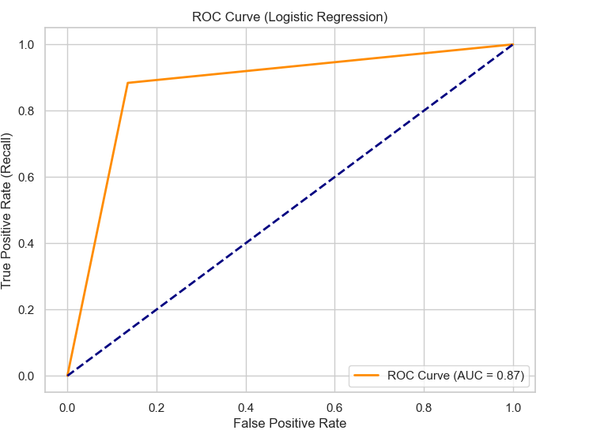
Finding the ROC Curve
True Positive Rate (Recall) vs False Positive Rate:
The True Positive Rate (also called recall) is plotted against the False Positive Rate. The curve shows how well the model distinguishes between fraudulent and non-fraudulent claims across different threshold values.
Model Performance:
The curve above the diagonal line (dashed blue line) indicates that the model is performing better than random guessing. The AUC (Area Under the Curve) value of 0.87 indicates that the model has good discriminative power, where 1 would mean perfect classification and 0.5 would mean random performance
.
AUC (Area Under the Curve): 0.87
The AUC value of 0.87 suggests that the model is highly effective at distinguishing between fraudulent and legitimate claims, with 87% accuracy in distinguishing between the classes.

Slide 18
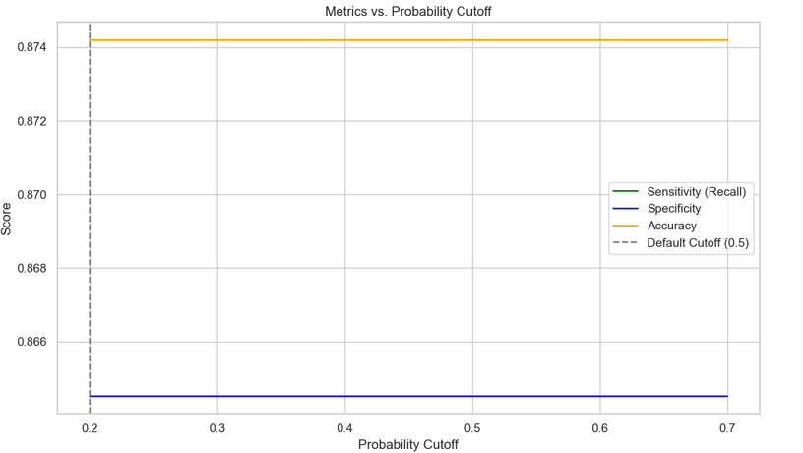
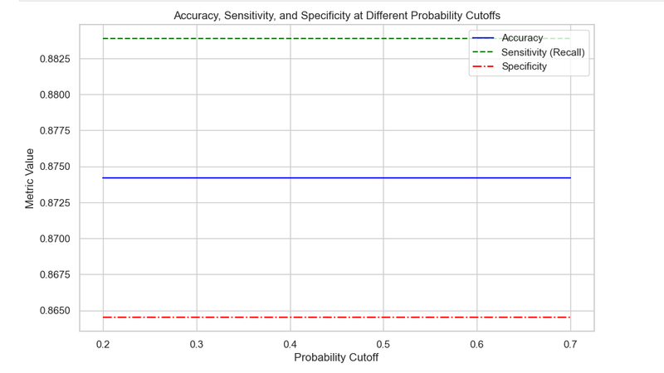
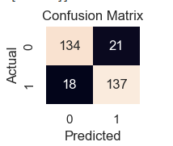
Optimizing Fraud Detection Model Performance Using Probability Cutoff
Cutoff Exploration:
Different probability cutoffs were tested to evaluate their impact on model performance. The cutoff values ranged from 0.2 to 0.7, as shown in the first image.
Optimal Cutoff:
The best performance was achieved with a probability cutoff of 0.2.
Model Performance at Optimal Cutoff:
Confusion Matrix:
True Positives: 137
False Positives: 21
True Negatives: 134
False Negatives: 18
Accuracy: 87.42%

Slide 19
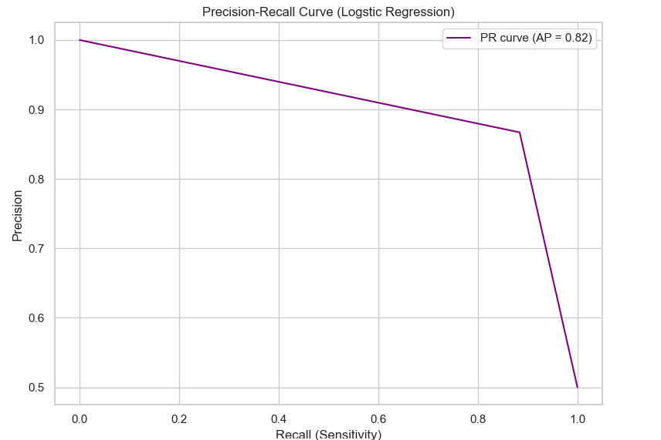
Optimizing Fraud Detection Model Performance Using Probability Cutoff
Key Metrics:
Sensitivity (Recall): 88.39% – The model correctly identifies 88.39% of fraudulent claims.
Specificity: 86.45% – The model correctly identifies 86.45% of legitimate claims.
Precision: 86.71% – The model is 86.71% precise when predicting fraudulent claims.
F1-Score: 87.54% – Balancing precision and recall, the model's overall performance is strong.
Precision-Recall Curve:
The Precision-Recall Curve (shown in the third image) has an Average Precision (AP) of 0.82, indicating the model's ability to balance precision and recall effectively at different recall levels.

Slide 20
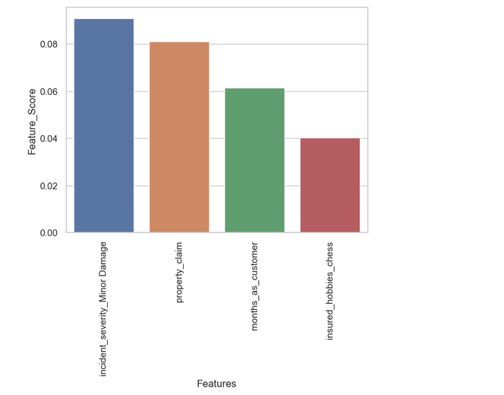
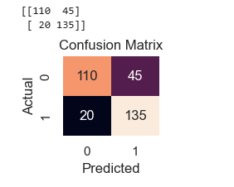
Random Forest Model Development, Evaluation, and Hyperparameter Tuning
Random Forest
Feature Selection and Model Training:
Selected Features: Chose the most important features based on feature importance scores.
Model: Used a Random Forest classifier.
Training Accuracy: 100% on training data, indicating possible overfitting.
Evaluation on Test Data:
Test Accuracy: 66.32%
Confusion Matrix:
True Positives (TP): 135
True Negatives (TN): 110
False Positives (FP): 45
False Negatives (FN): 20
Performance Metrics (Before Hyperparameter Tuning):
Sensitivity (Recall): 1.0 – The model identifies 100% of fraudulent claims.
Specificity: 1.0 – The model identifies 100% of legitimate claims.
Precision: 1.0 – 100% of predicted fraudulent claims are accurate.
F1-Score: 1.0 – Balanced performance across metrics.

Slide 21
Random Forest Model Development, Evaluation, and Hyperparameter Tuning
Random Forest
Cross-Validation Results:
Mean Accuracy: 70.65%
Standard Deviation: 2.77% – Consistent performance across different folds.
Hyperparameter Tuning:
Best Hyperparameters:
class_weight='balanced', criterion='entropy', max_depth=5, max_features='sqrt', min_samples_leaf=2, n_estimators=100
Best Accuracy Score: 75.89%
Final Model Performance (After Hyperparameter Tuning):
Training Accuracy: 79.03%
Confusion Matrix: (As shown in the third image)
Sensitivity: 87.10%
Specificity: 70.97%
Precision: 75%
Recall: 87.10%
F1-Score: 80.60%

Slide 22
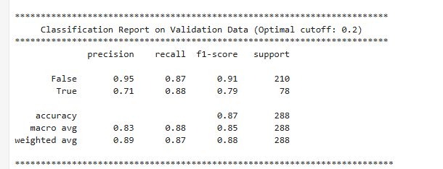
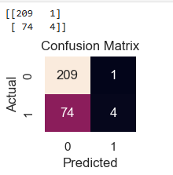
Evaluation of Logistic Regression and Random Forest Models for Fraud Detection
Model Performance Evaluation: Logistic Regression vs. Random Forest
1. Logistic Regression Model on Validation Data:
Accuracy: 73.96% on validation data.
Confusion Matrix:
True Positives (TP): 4
True Negatives (TN): 209
False Positives (FP): 1
False Negatives (FN): 74
Metrics:
Sensitivity (Recall): 5.13% – The model only detects 5.13% of fraudulent claims.
Specificity: 99.52% – The model correctly identifies 99.52% of legitimate claims.
Precision: 80% – The model is 80% precise when predicting fraudulent claims.
F1-Score: 9.64% – The low F1-score indicates a significant imbalance between precision and recall.

Slide 23
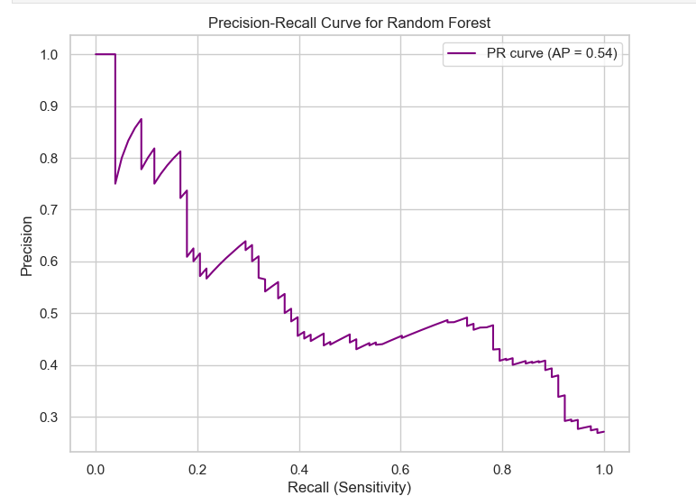
Evaluation of Logistic Regression and Random Forest Models for Fraud Detection
2. Random Forest Model on Validation Data:
Accuracy: 73.96% on validation data (same as logistic regression).
Confusion Matrix:
True Positives (TP): 4
True Negatives (TN): 209
False Positives (FP): 1
False Negatives (FN): 74
Metrics:
Sensitivity (Recall): 5.13% – Again, the model detects only 5.13% of fraudulent claims.
Specificity: 99.52% – The model performs well at identifying legitimate claims.
Precision: 80% – 80% of predicted fraudulent claims are actually fraud.
F1-Score: 9.64% – Low F1-score indicating a poor balance between precision and recall for fraud detection.
3. Precision-Recall Curve:
AP (Average Precision): 0.54
The Precision-Recall curve shows that the model struggles with detecting fraudulent claims, as evident from the sharp drop in precision as recall increases, which is visible in the curve.

Slide 24
Model Comparison and Insights
Random Forest outperformed Logistic Regression across key metrics, with an ROC AUC of 0.90, showcasing excellent ability to distinguish between fraudulent and non-fraudulent claims.
Logistic Regression, while slightly behind with an ROC AUC of 0.79, demonstrated high precision (≈ 0.93), making it an ideal choice for minimizing false positives in fraud detection.
The Precision-Recall Curve for Logistic Regression (AP = 0.77) indicates strong precision across various recall levels, particularly valuable in highly imbalanced datasets like fraud detection.
Random Forest showed better generalization with a validation accuracy of ~90%, maintaining a balanced precision-recall, suggesting robust performance in detecting both fraud and non-fraud cases.
The Random Forest ROC curve significantly outperforms the diagonal, affirming its effectiveness in separating fraud from non-fraud cases.
However, Random Forest’s very high training accuracy (~99.7%) suggests potential overfitting, which can be mitigated through hyperparameter tuning or tree depth limitations

Slide 25
Conclusions
Key Insights for Fraud Detection
Analyzing Historical Claim Data:
By examining features like claim amounts, incident severity, customer tenure, and claim types, we can identify patterns that suggest potential fraud. For example, high-value claims and certain customer profiles (e.g., self-employed or students) are often associated with higher fraud risk.
Feature engineering (e.g., creating interaction features like age-deductible interactions) can further enhance model performance in identifying fraudulent claims.
Most Predictive Features for Fraudulent Behavior:
Incident Severity (Minor Damage): This feature is highly predictive of fraudulent claims.
Property Claims: Claims involving property damage are strongly associated with fraud.
Customer Tenure: Newer customers are more likely to file fraudulent claims than long-term customers.
Hobbies and Occupation: Certain hobbies and occupations (like students and unemployed) correlate with increased fraud risk.
Predicting Fraud for Incoming Claims:
Based on historical data, models like Random Forest and Logistic Regression can accurately predict the likelihood of fraud in new claims. The Random Forest model showed an AUC of 0.90, confirming its effectiveness in fraud detection.

Slide 26
Conclusions
Improving Fraud Detection:
Feature Importance: Key features like incident severity and property claims should be prioritized for future models.
Sensitivity vs Specificity: The model has high specificity but low sensitivity, indicating missed fraudulent claims. Adjusting the cutoff threshold can improve sensitivity.
Precision-Recall Balance: Precision-Recall curves highlight the need to balance precision and recall, especially in imbalanced fraud datasets.
Overfitting: The model’s high training accuracy suggests overfitting. Hyperparameter tuning and cross-validation should be employed to mitigate this issue.

Slide 27
Thank you

